Slide 1

CSE 6363: Project Review 2
<Mihir Ingole, Eldho Joy, Dannasri Srinivasan>

Slide 2
Classification of Autism Spectrum disorder using computer vision with deep learning and the ABIDE dataset
WHO: ASD affects one child in 160 worldwide CDC : ASD affects one in 68 children in the United States
Identification of Autism Spectrum Disorder
Diagnosing neurological diseases requires a model based on functional or structural region relationships in the brain
Functional magnetic resonance imaging (fMRI) is used to study the brain and its structures
Autism brain imaging data exchange (ABIDE) involving neuroimaging and phenotypic data obtained from 1,112 individuals with 539 ASD patients and 573 others, from 17 sites

Slide 3
ABIDE dataset
ABIDE I is a consortium of collected resting-state fMRIs from 17 international imaging sites and matched controls that is provided for scientific research
Each site in the ABIDE I dataset uses different parameters and protocols.
fMRI is based on neural measurements of functional connectivity between multiple brain regions.
These datasets contain T1 structural brain images, fMRI images, and phenotypic information relating to different patients.
The phenotypic information is classified based on sex, age, and autism diagnostic observation schedule (ADOS) score for ASD subjects and mean framewise displacement (FD) quality.

Slide 4
ABIDE dataset
Caltech_0051456_reho

Slide 5
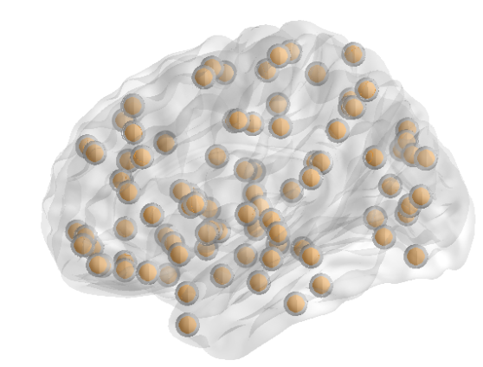
Data Pre-Processing
Preprocessed Connectomes Project (PCP) is a publicly available preprocessed version of data
We’ll be using data using the configurable pipeline, the Analysis of Connectomes (CPAC).
The preprocessing step includes slice timing correction, correction for motion, and normalization of voxel intensity
Nuisance regression to delete the signal fluctuations caused by head motion, respiration, cardiac pulsation, and scanner drift
CC400 functional parcellation atlas
AAL90 (automated anatomical labeling)

Slide 6
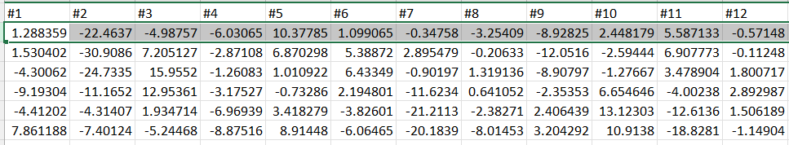
Data Pre-Processing Configurations:
Derivative: Region of interest CC400.
Pipeline: CPAC
Strategy: Band-pass filtering and global signal regression

Slide 7
Different parameters in structural MRI imaging for each site in the ABIDE I dataset.
 | Voxel size (mm3) | Flip angle (deg) | TR (ms) | TE (ms) | T1 (ms)
CALTECH | 1 | 10 | 1,590 | 2.73 | 800
CMU | 1 | 8 | 1,870 | 2.48 | 1,100
KKI | 1 | 8 | 8 | 3.7 | 843
LEUVEN | 0.98×0.98×1.2 | 8 | 9.6 | 4.6 | 885.145
MAXMUN | 1 | 9 | 1,800 | 3.06 | 900
NYU | 1.3×1.3 | 7 | 2,530 | 3.25 | 1,100
OHSU | 1 | 10 | 2,300 | 3.58 | 900
OLIN | 1 | 8 | 2,500 | 2.74 | 900
PITT | 1.1×1.1×1.1 | 7 | 2,100 | 3.93 | 1,000
SBL | 1 | 8 | 9 | 3.5 | 1,000
SDSU | 1 | 45 | 11.08 | 4.3 | NA
STANFORD | 0.86×1.5×0.86 | 15 | 8.4 | 1.8 | NA
TRINITY | 1 | 8 | 8.5 | 3.9 | 1060.17
UCLA | 1×1×1.2 | 9 | 2,300 | 2.84 | 853
UM | 1.2×1×1 | 15 | 250 | 1.8 | 500
USM | 1×1×1.2 | 9 | 2,300 | 2.91 | 900
YALE | 1 | 9 | 1,230 | 1.73 | 624

Slide 8
Thank You!

